Slide 1


Project 3&4 Customer behavior
Fabio Mongillo

Slide 2



Project objectives
Objective 1: Deep-dive into consumer behavior data - identify trends, uncover patterns, prepare for predictive modeling.
Objective 2: Build an efficient and accurate machine learning model to predict future consumer behavior.

Slide 3




Introduction
This project examines consumer behavior data acquired from a reputable retail website. Given the inherent limitations of the dataset, the objective is to leverage data science techniques to:
Conduct a comprehensive Exploratory Data Analysis (EDA)
Develop a machine learning model for predicting purchase behavior
Extract actionable insights from the model

Slide 4

Data Cleaning and EDA
Data Wrangling:
Cleaning Missing Values: Strategically impute missing values using mode for categorical features and mean/median for numerical features, maintaining data integrity.
Feature Engineering: Extract relevant information and transform features for optimal modeling.
Exploratory Analysis (EDA):
Visualization: Employ diverse visualizations (histograms, boxplots, scatter plots) to uncover trends, patterns, and relationships within the data.
Outlier Identification: Detect and address outliers that might distort model performance.
Correlation Analysis: Quantify relationships between variables to understand potential dependencies and guide feature selection.

Slide 5
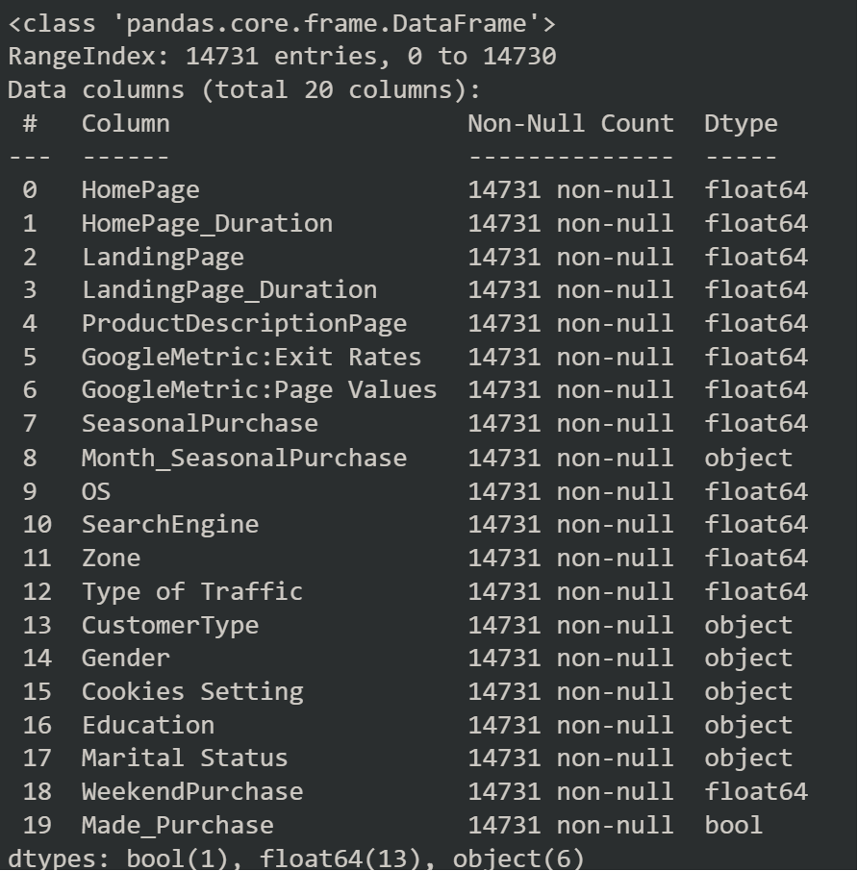
Data Cleaning and EDA
removed highly correlated columns to avoid redundancy

Slide 6
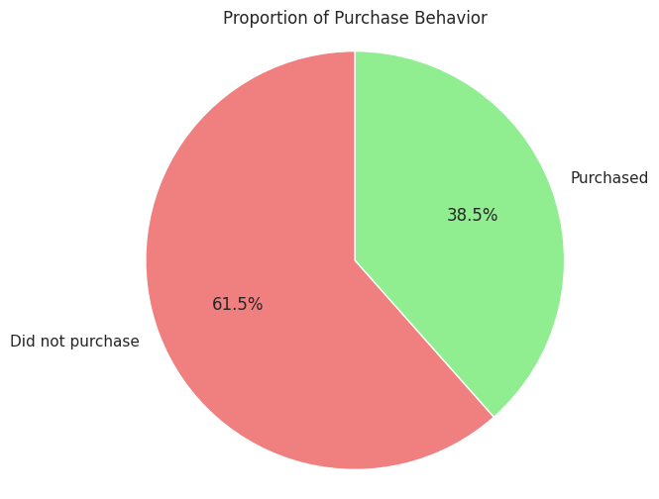
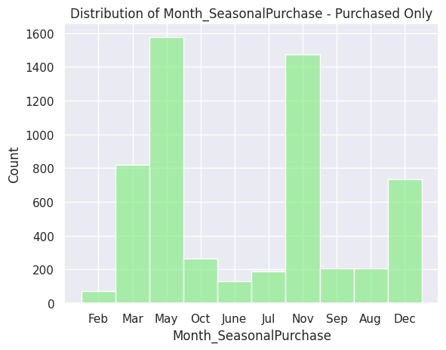
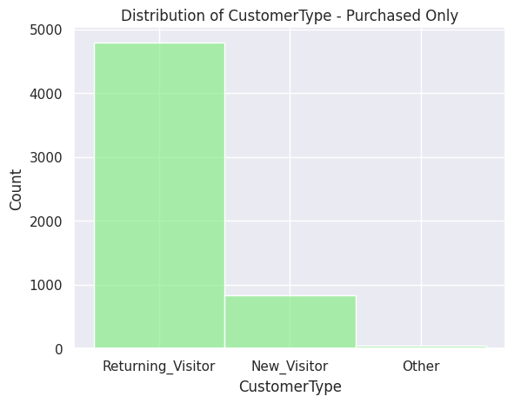
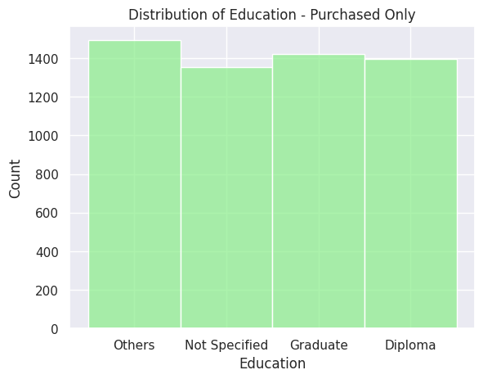
Data Cleaning and EDA
Visualization: Employ diverse visualizations (histograms, scatter plots, pie charts) to uncover trends, patterns, and relationships within the data.
Correlation Analysis: Quantify relationships between variables to understand potential dependencies and guide feature selection.

Slide 7

Machine Learning Model
Model used for the project:
Gradient Boosting: Combines weak learners (e.g., decision trees) into a stronger model, iteratively improving predictions based on previous errors. Good for complex, non-linear problems.
SVM: Creates a decision boundary to separate data points into classes. Can handle high-dimensional data but may require careful parameter tuning.
KNN: Classifies data points based on the majority vote of their nearest neighbors. Simple to implement but sensitive to irrelevant features and outliers.
Random Forest: Ensemble method averaging predictions from multiple decision trees, reducing overfitting and increasing robustness. Good for general-purpose classification.
Decision Tree: Learns simple rules by splitting data based on features. Fast and interpretable, but prone to overfitting for complex problems.
This Photo by Unknown Author is licensed under CC BY

Slide 8
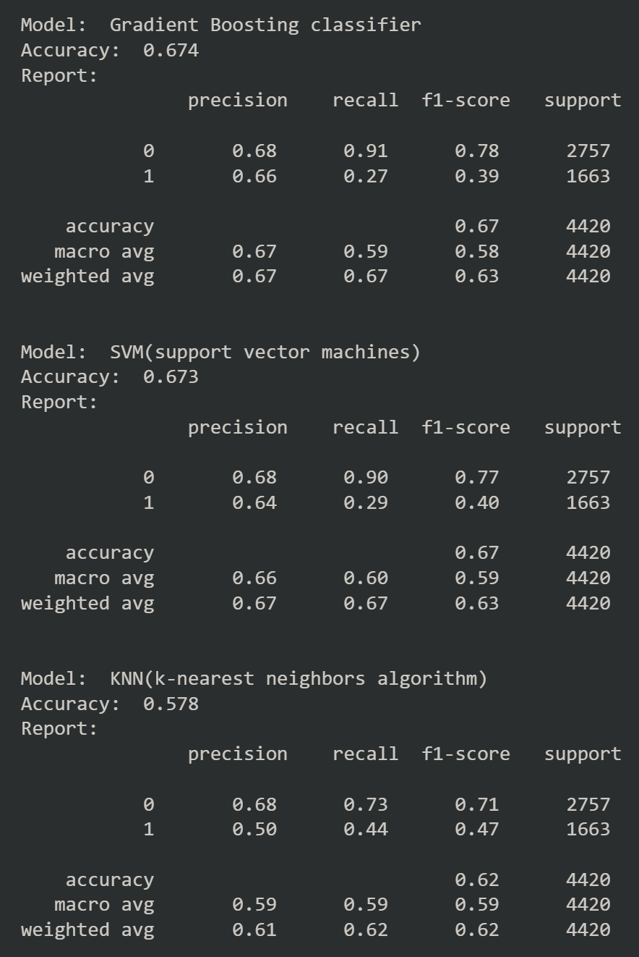
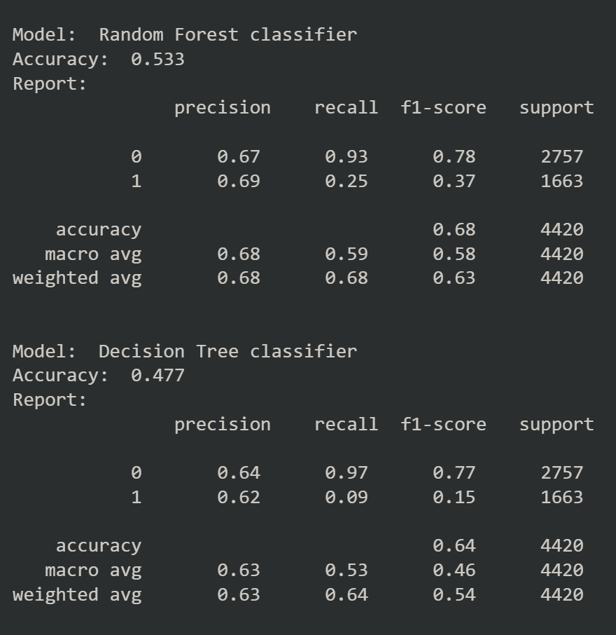
Results
While the Gradient Boosting classifier boasts the highest accuracy (67.4%) among the tested models, relying solely on this metric can be misleading. While it suggests strong potential for accurate predictions, accuracy alone doesn't guarantee a model's true performance. It's essential to remember that models prone to overfitting often exhibit exceptional performance on training data but struggle with unseen data. Further evaluation on a separate validation set would be required.

Slide 9

Conclusions
Observations from the table:
All models except KNN have accuracy above 0.6, which is relatively high. This could be an indication of overfitting, but more analysis is needed.
Most models have similar accuracy with small variations. This also suggests potential overfitting, as different models shouldn't perform identically if they're truly capturing different patterns.
Several models (Random Forest, Gradient Boosting, SVM) have precision and recall significantly higher for class 0 (not purchased) compared to class 1 (purchased). This imbalance can sometimes be a sign of overfitting, especially if it doesn't reflect the actual class distribution in the data.
Recommendations:
To train and evaluate the models on a separate validation dataset.
Use cross-validation techniques to get a more reliable estimate of model performance.
Consider techniques like regularization or data augmentation to prevent overfitting in complex models.

Slide 10


Thank You
Fabio Mongillo
For more details check: https://github.com/Einsteinious/Project-3-4-EDA-Machine-Learning/blob/main/Project3%264_customer_behavior.ipynb

